Slide 1
MANNATECH INC.
PURGING IN 2022
Part I - with David Wood

Slide 2
WHAT???
What is a Purge?
A Purge is a removal of all inactive Associates who have not renewed their accounts and have not placed a product order in two years. Additionally, all Preferred Customer positions that have not purchased any products within two years will be purged from our records. Beginning January, 2022, we will remove all inactive Associate and Preferred Customer positions, globally on a Monthly basis.
What happens?
After commissions run and checks post around the 15th of a month, the I.T. Department will begin to remove the accounts as mentioned above. The Purge will be completed by Month End. The results could bring about an increased number of legs which could lead to more leader development without any additional Downline Point Volume (DPV) or Commissionable Volume (CV) contribution. All positions that were sponsored by the purged positions will be moved under the next active position in the line of sponsorship. This could potentially increase the number of legs for the active Associates (reverse leg consolidation).

Slide 3
WHY???
Why Purge?
Breathes “new life” into our database.
Streamline data to maximize efficiencies.
Equip Leaders to reconnect with, and re-engage, former high consumers.

Slide 4
WHO???
Who needs this Purge Training?
All Associates not ordering or renewing in two years.
All Associates with Personally Enrolled/Sponsored Customers.
All Associates with a Downline Team.
Leaders wanting to re-engage their Team and their Business!
Anyone in Mannatech that is unaware of the Purge.

Slide 5
PAST
When did Mannatech Purge?
Purge Date | Purged Account Count
2/20/2016 | 2,349,486
2/20/2017 | 25,816
5/25/2019 | 404,502
7/18/2020 | 102,161

Slide 6
PRESENT
Will we be ready for the next Purge in January, 2022?
We all need to do at least two things, which is covered here in Part I.
Capture the picture of my Organization before the Purge occurs so I can benefit both myself and my Team.
Store that Data in a safe place (preferably two places).
Leaders will take advantage of this and seize the opportunity which is covered in Part II to increase retention, and maximize their Business Opportunities.
Let’s Get Ready!

Slide 7
FUTURE
Since MANNATECH INC. will begin to Purge every month in 2022, this training (PART I) applies each month after Commission Runs.
We recommend doing the simple steps covered in this training in the first couple of weeks in a Month.

Slide 8
EMPOWERMENT TRAINING
Let’s begin PART I of our Training and remember, this is for everyone! If you don’t do anything else, get “Part I” done so you are ready to roll!
PART 1 – For EVERYONE
Capture and save your team data.
PART 2 – For LEADERS
Engage your Leadership team.
Prioritize your contact strategy.

Slide 9
Capture Your Team Data
OUR TASK

Slide 10
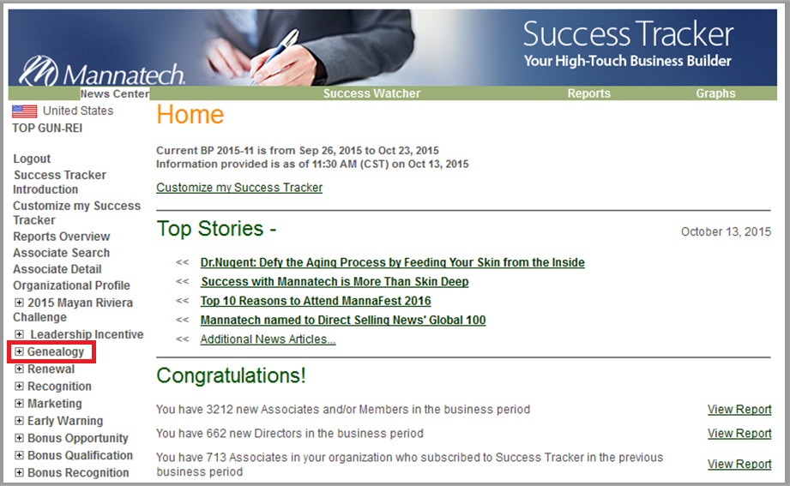
GENEALOGY REPORT
Click on “Genealogy” to open these reports.

Slide 11
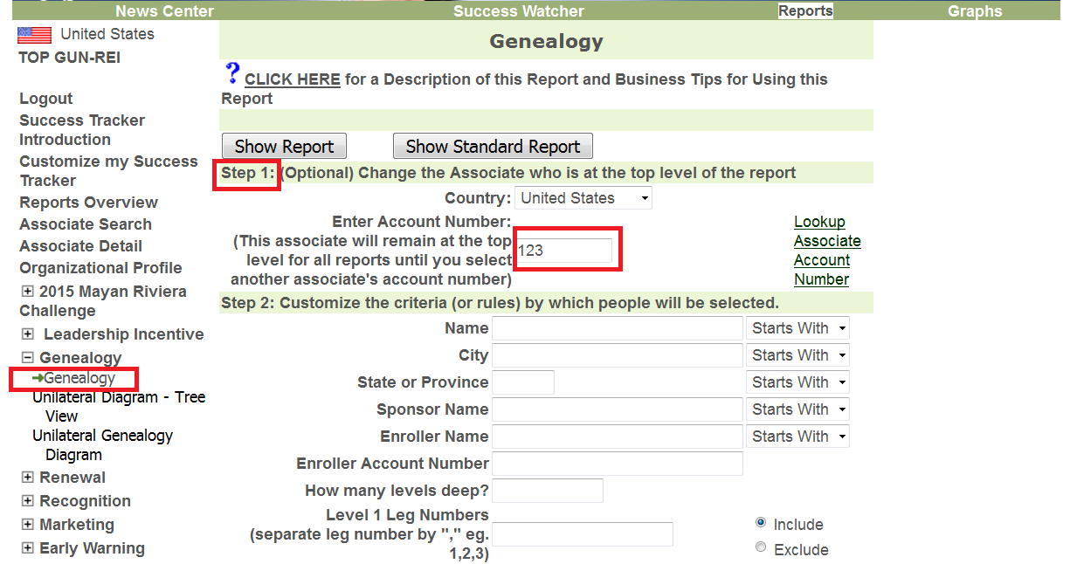
CUSTOMIZATION STEPS
Step 1: Enter YOUR Country and Account # – or the Account of your downline Leader.
Skip Steps 2 & 3, Scroll down to Step 4
Click on “Genealogy”

Slide 12
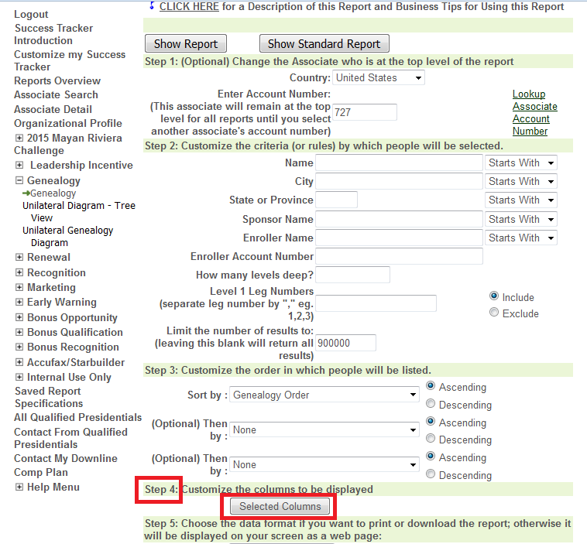
STEP #4
Step 4: Click on “Selected Columns” to select the columns you will like the report to show

Slide 13
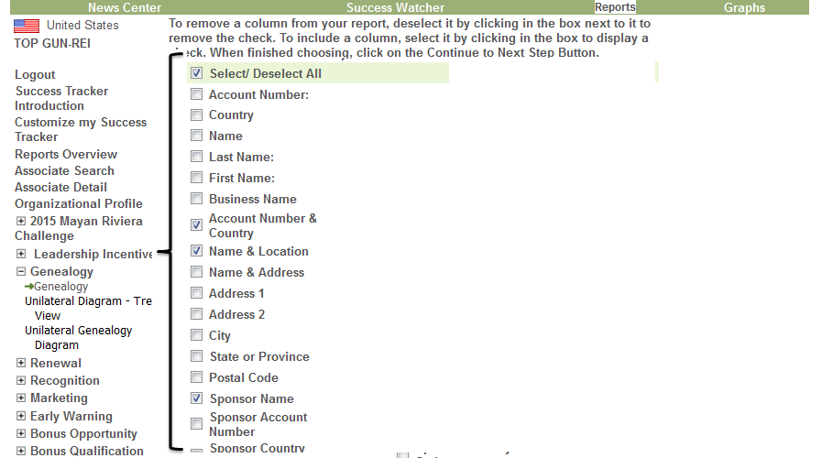
CUSTOMIZATION STEPS
Check the “Select/
Deselect All” Check Box to get it ALL.
Scroll all the way down

Slide 14
ON TO STEP #5
After checking your selections,
Click here!

Slide 15
HOW DO YOU WANT IT?
Step 5: Change the data format from Web Page to
Tab Delimited! Then, click “Show Report” in Step 6.

Slide 16
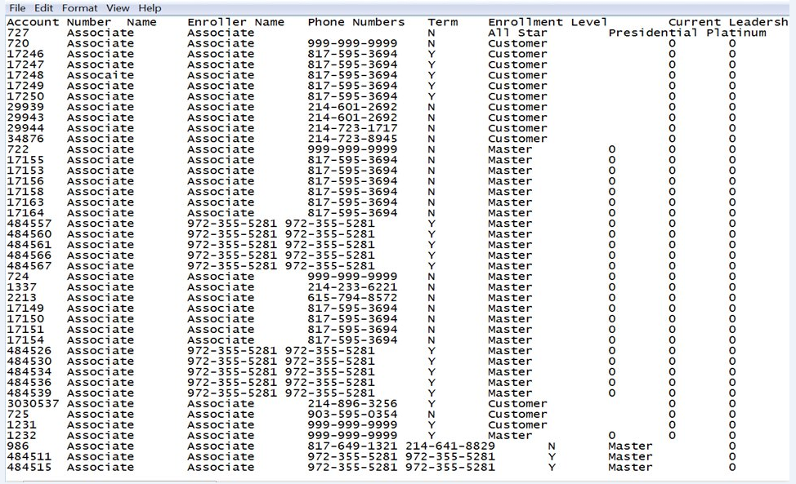
RAW DATA
The report will list the columns you selected and will look similar to this…

Slide 17
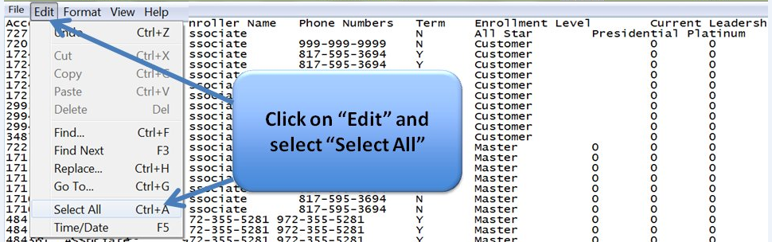
SELECTION
Click on “Edit” and select “Select All”

Slide 18
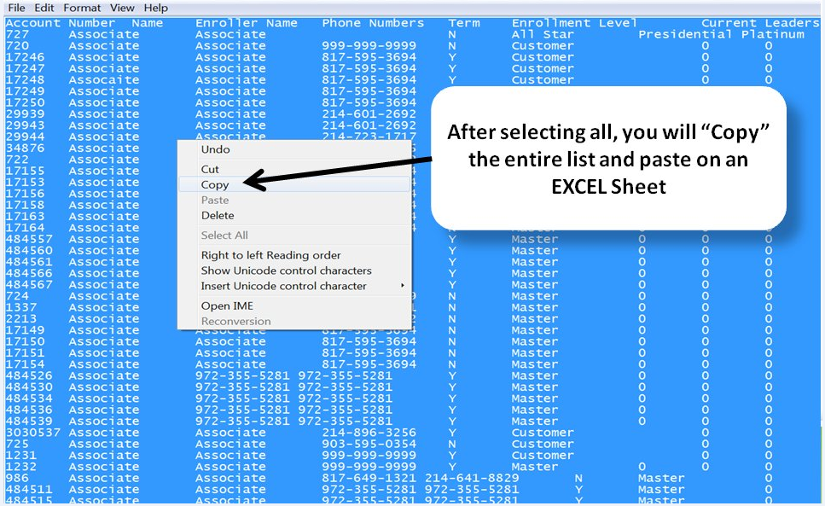
COPY
After selecting “All”, you will “Copy” the entire list and paste on an EXCEL Sheet

Slide 19
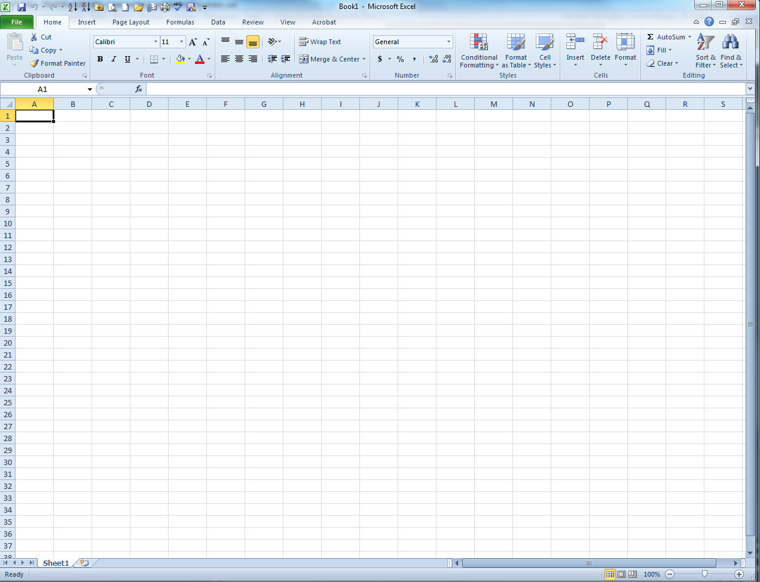
PASTE
Paste
Move your cursor to the top left corner
Excel

Slide 20
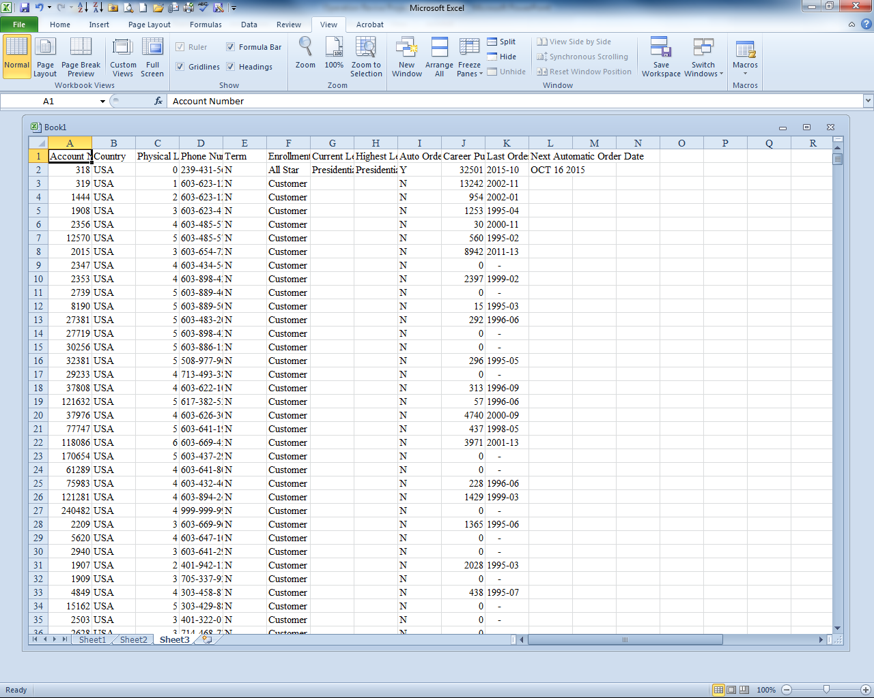
YOU GOT IT!
Excel after Pasting

Slide 21
SAVE IT!
Save it into your own filing system.

Slide 22
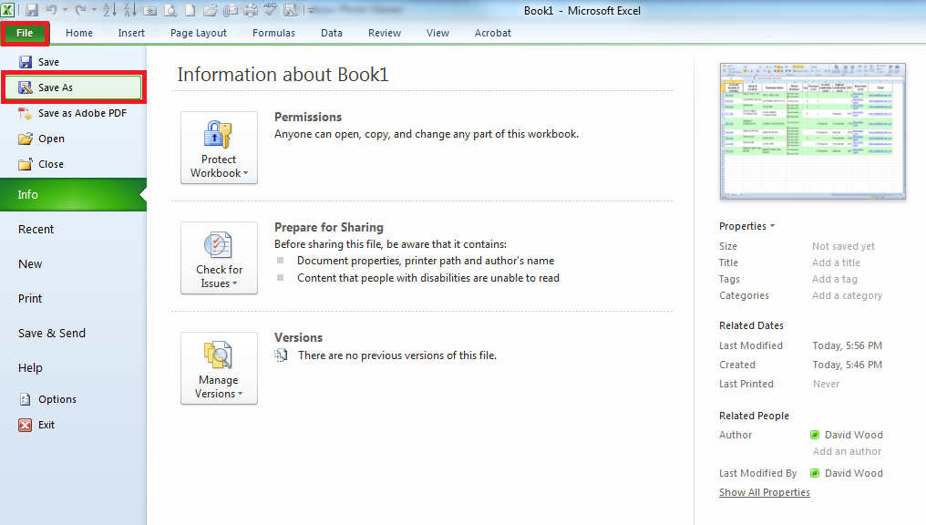
SAVE IT IN TWO PLACES FOR SAFETY
Save it As a document on your own Hard Drive

Slide 23
INCOME DISCLAIMER
Disclaimer
Building a business takes time and a lot of hard work. All commissions and bonuses are earned through the sale of Mannatech products. Mannatech does not guarantee the amount of income or incentive rewards, if any, that an Associate participating in the Mannatech business will generate. As with any business, each Associate’s business results may vary and will be based on, among other factors, the Associate’s effort and skill, the customer base available to him or her, and the time devoted to the business.
The earnings or lifestyle indicated are not necessarily representative of what you may earn or achieve. Your individual earnings and lifestyle as an Associate are strictly dependent upon your respective area, skills, and effort. Mannatech makes no guarantee of earnings or lifestyle.

